Slide 1
Lecture 6: Species distributions and 2D spatial models
May 1, 2018

Slide 2
Why might we care about 2D spatial models?
Experimental plots
Often uses grid
Observational analysis
Fish surveys

Slide 3
2D spatial models
Species distribution models
Widely used tool in zoology, conservation-planning, and invasion biology
Synonyms:
Climate envelop model – Fit model to species observations, and then identify other areas with suitable conditions
Species density model – Sometimes used when fitting to density rather than presence/absence data
Often used to infer “Grinnellian niche”
Assumes distribution is a product of habitat variables that are measurable and whose action is local

Slide 4
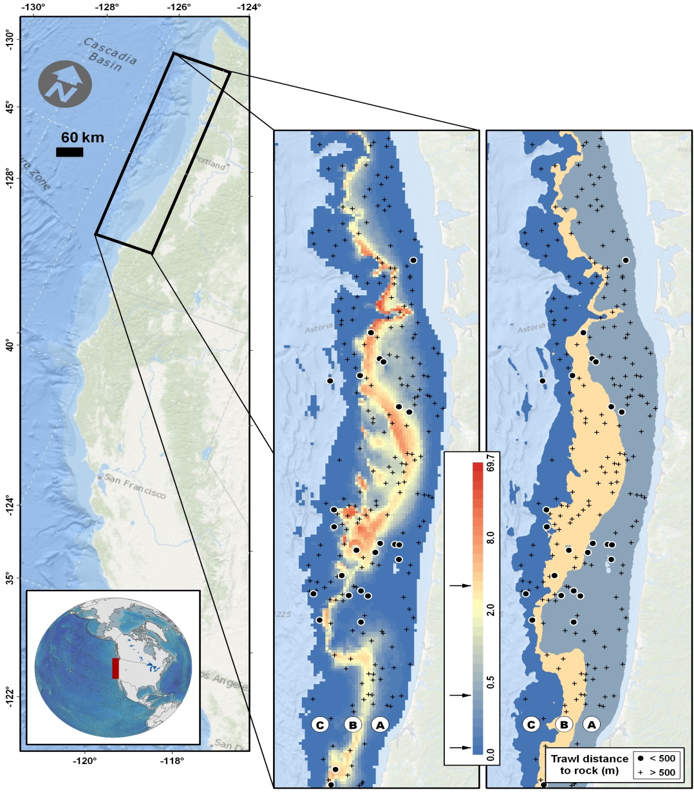
2D spatial models
Spatial models are useful for estimating species distribution
Capture fine-scale variation
Decrease residual variation -> Decrease standard errors
Shelton Thorson Ward Feist (2014) CJFAS

Slide 5
2D spatial models
Two potential treatments
Equally spaced grid
Unequal or sporadic spacing

Slide 6
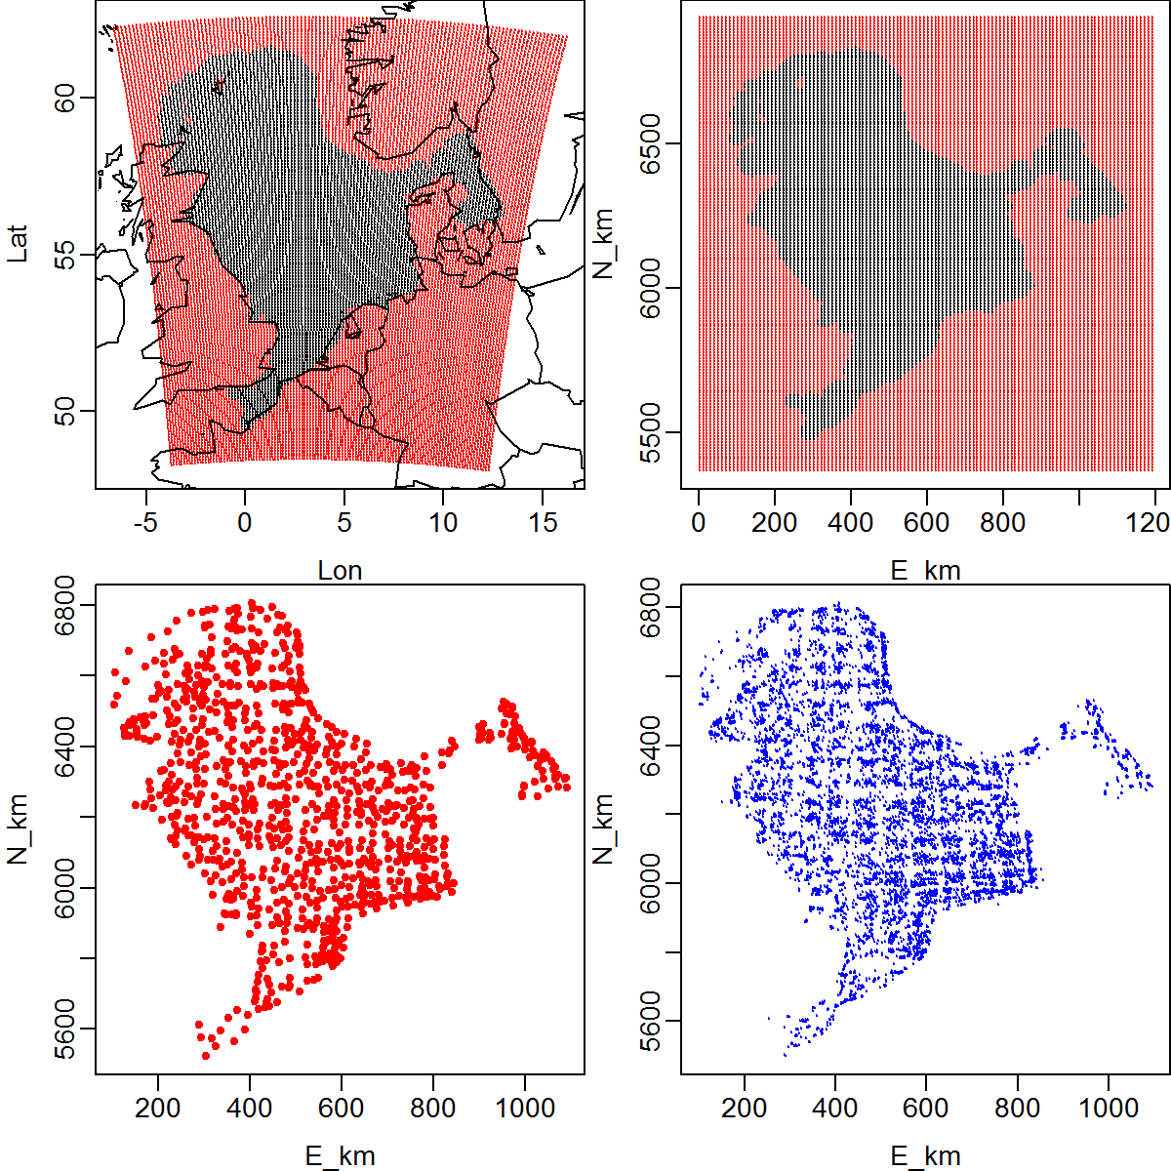
2D spatial models
Two potential treatments
Equally spaced grid
Example #1: Divide north sea into grid
Domain of samples
(black: Included)
Location of samples

Slide 7
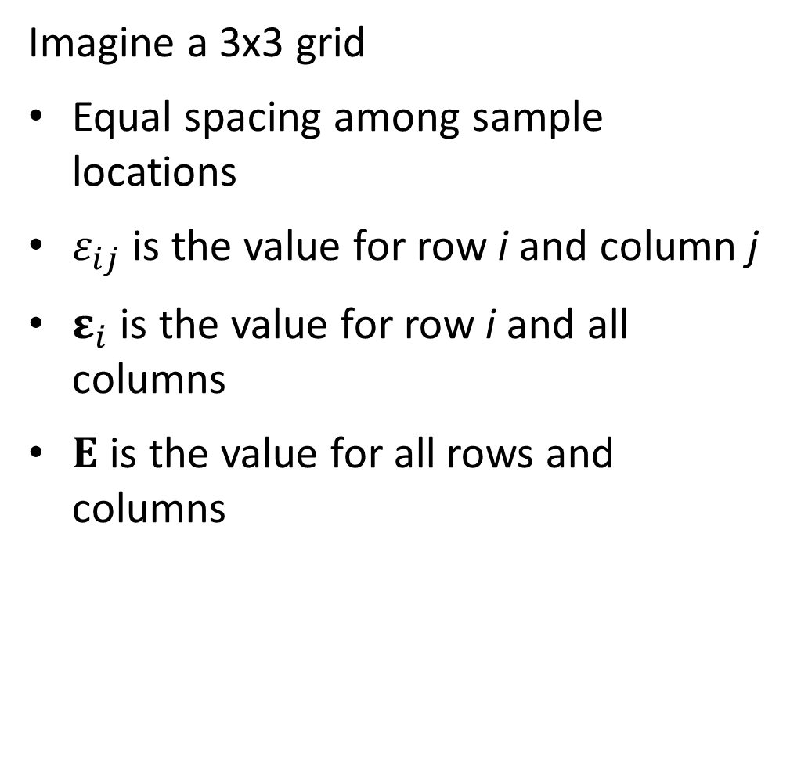
2D spatial models
Imagine a 3x3 grid
Equal spacing among sample locations
$ε_{ij}$ is the value for row i and column j
$ε_{i}$ is the value for row i and all columns
$Ε$ is the value for all rows and columns

Slide 8

2D spatial models
Review
Let’s assume first-order autoregression:
$$ε_{s+1}\sim Normal(cε_{s},σ_{ε}^{2})$$
Then the joint distribution is multivariate normal
$$ε\sim MVN(0,Σ)$$
Where

Slide 9
2D spatial models
Intuitive to extend this
What is the distribution for Row #2 conditional on Row #1
[Work through on board]
Row #
1
2
3

Slide 10
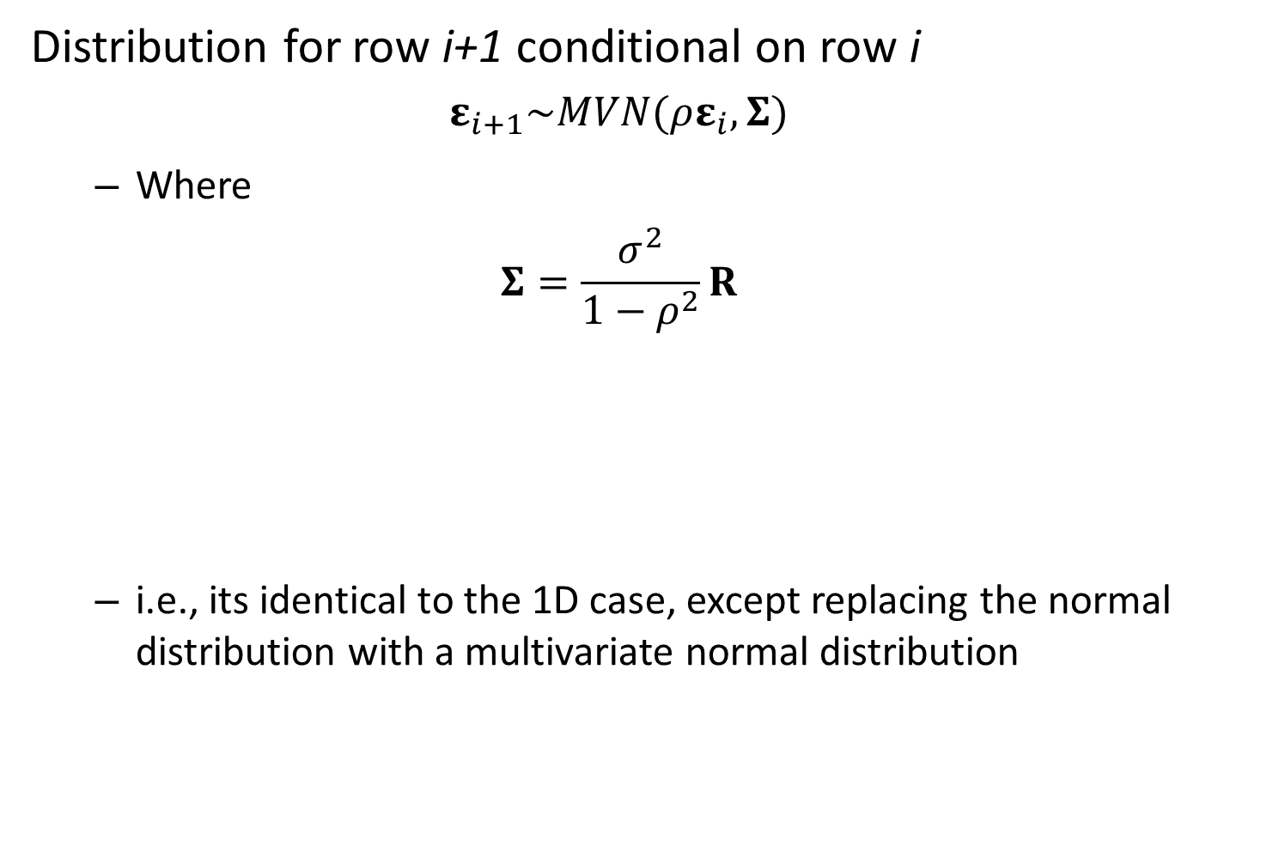
2D spatial models
Distribution for row i+1 conditional on row i
$$ε_{i+1}\sim MVN(ρε_{i},Σ)$$
Where
$$Σ=\frac{σ^{2}}{1−ρ^{2}}R$$
i.e., its identical to the 1D case, except replacing the normal distribution with a multivariate normal distribution

Slide 11

2D spatial models
Joint distribution of all sites
Then:
$$vec\left(Ε\right)\sim MVN(0,Σ_{total})$$
Where
$$Σ_{total}=\frac{σ_{ε}^{2}}{1−ρ^{2}}R_{total}$$

Slide 12
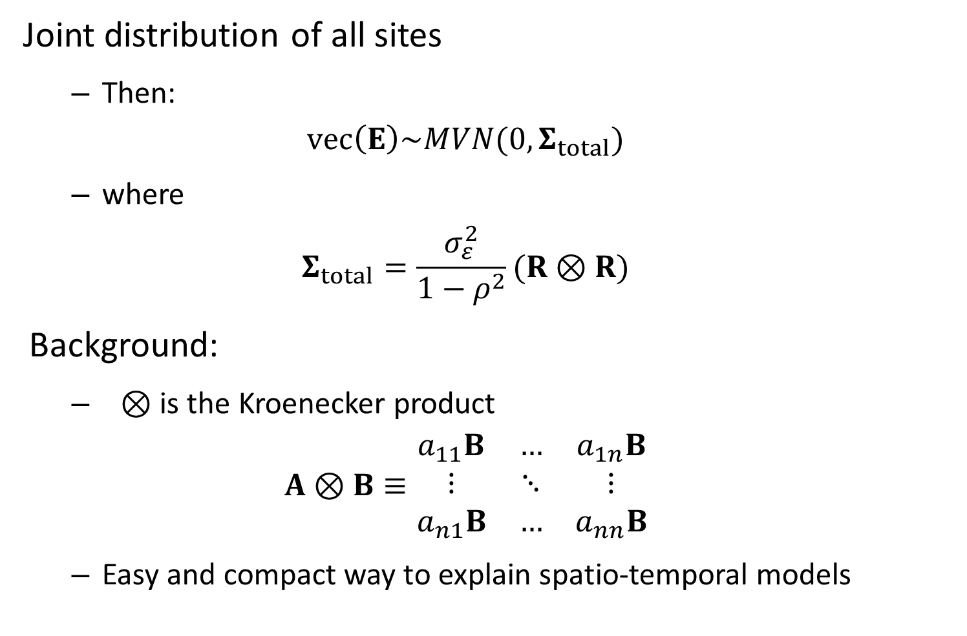
2D spatial models
Joint distribution of all sites
Then:
$$vec\left(Ε\right)\sim MVN(0,Σ_{total})$$
where
$$Σ_{total}=\frac{σ_{ε}^{2}}{1−ρ^{2}}(R⊗R)$$
Background:
$⊗$ is the Kroenecker product
$$A⊗B≡\begin{matrix}a_{11}B & … & a_{1n}B \\ ⋮ & ⋱ & ⋮ \\ a_{n1}B & … & a_{nn}B\end{matrix}$$
Easy and compact way to explain spatio-temporal models

Slide 13

2D spatial models
Kroenecker product inverse is easy
$$Σ_{total}^{−1}={\frac{1}{σ_{ε}^{2}}\left(Q⊗Q\right)}^{−1}=\frac{1}{σ_{ε}^{2}}\left(Q^{−1}⊗Q^{−1}\right)$$
where we know how to calculate $Q^{−1}$

Slide 14

2D spatial models
Kroenecker product conserves “sparseness”
If $A$ …
is $n_{A}$ by $n_{A}$
It has $n_{A}^{2}$ elements
But has $m_{A}<n_{A}^{2}$ non-zero elements
It has “sparseness” = $m_{A}/n_{A}^{2}$
If $B$ …
has $m_{B}<n_{B}^{2}$ non-zero elements
Then $A ⨂{B}$…
Has “sparseness” $({m_{B}m}_{A})/{\left(n_{A}n_{B}\right)}^{2}$

Slide 15
Look at GitHub functions
AR1
http://kaskr.github.io/adcomp/classdensity_1_1AR1__t.html
SEPARABLE
http://kaskr.github.io/adcomp/classdensity_1_1SEPARABLE__t.html

Slide 16
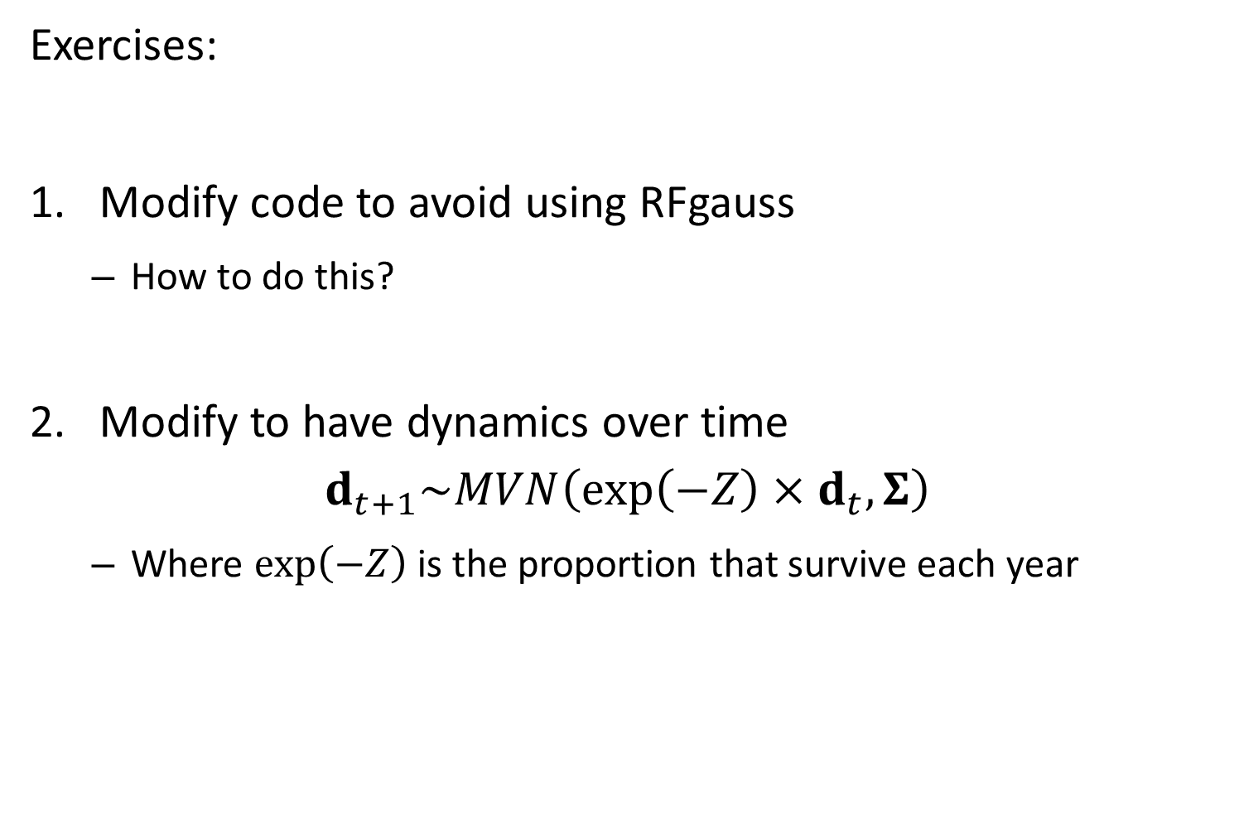
Exercises:
Modify code to avoid using RFgauss
How to do this?
Modify to have dynamics over time
$$d_{t+1}\sim MVN\left(\exp\left(−Z\right)×d_{t},Σ\right)$$
Where $\exp\left(−Z\right)$ is the proportion that survive each year

